Slide 1
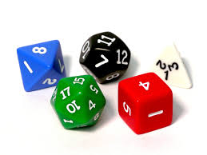
Probability Interactive Notebook
Name
Class
Teacher
Term 1 Semester 1
1

Slide 2
Revision
If a letter if picked at random from the word REVISION find;
P(i)
P(R)
P(v)
P(a vowel)
P( a consonant)
2/8
1/8
1/8
4/8
4/8

Slide 3
24
7
30
Date
Complementary events
EQ – What are complementary events?
What does complement mean in probability?
Complement means an event not happening
The complement of having long hair is the not having long hair.

Slide 4
Write the complement for each of the following
Wearing hat
Having a red shirt
Not having gloves
Winning a game of tennis
The ball is yellow

Slide 5
24
7
30
Date
Complementary events
EQ – What are complementary events?
What does complement mean in probability?
Complement means an event not happening
The complement of having long hair is the not having long hair.
What is an easy way of writing complements?
The complement of event A is not event A which can be written as A’
Not A = A’
How can I use complements?
The sum of the probability of an event and its complete is 1
P(A)+P(A’)=1
Therefor P(A’)= 1 - P(A)

Slide 6
Task
Dwyer text book
Pg 55

Slide 7
Homework
Review your notes and write a summary answering the essential question.

